Slide 1
How Education Level Influences Cannabis Consumptions
Claudia Tung, Will Everett, Alex Latendresse, Shuhan Wang, Cody Greene, Manu Lopez

Slide 2
Agenda
01
03
02
04
Problem & Hypothesis
Data &
Exploratory Analysis
Data Driven Approach & Ideal Experiment
Models & Conclusions

Slide 3
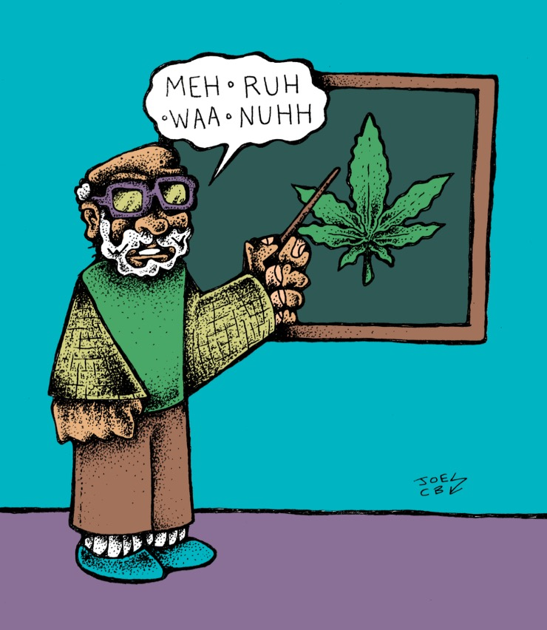
The Problem
Importance of understanding how education affects cannabis consumption
Create policies around drug usage
Teach responsible drug consumption
Develop proper drug prevention programs
Improve rehab facilities
Notes:
The question we wanted to answer was how education level influences whether someone has tried marijuana recreationally
This topic is important because understanding how education affects cannabis consumption can guide policy makers and schools in creating a suitable approach to create drug usage policies, teach the side effects and responsible use of marijuana, develop proper drug prevention programmes and improve rehab facilities

Slide 4
Hypothesis
H₀: Not pursuing higher education has no effect on the likelihood that someone will consume cannabis within the next month.
H_{A}: Not pursuing higher education has an effect on the likelihood that someone will consume cannabis within the next month.

Slide 5

Why a Data Driven Approach
Informs important business decisions, as potential strategies are backed up with evidence
Potential systematic biases present
Conclusions and implications may be affected/incorrect
Awareness of our model, after best attempting to eliminate these biases, better informs us about potential solutions to drug usage trends
Notes:
A Data Driven Approach is crucial when undertaking experiments like this.
Sometimes the eye test can be misleading, and basing decisions purely on intuition may not yield the most efficient results. The use of data analysis allows us inform important business decisions, as the reasons for choosing potential strategies are backed up with statistical evidence.
However, in order for us to implement a data driven approach, we must understand the data generating process, knowing where exactly our data comes from. We must understand the limitations of our data, and must be informative about the systematic biases potentially apparent in our models. If the data is taken as is, the implications taken away are going to be affected, and conclusions and implications will be incorrect.
In this case Cannabis has been widely regarded as harmful allow us to understand links → and who we can target if there is a link

Slide 6
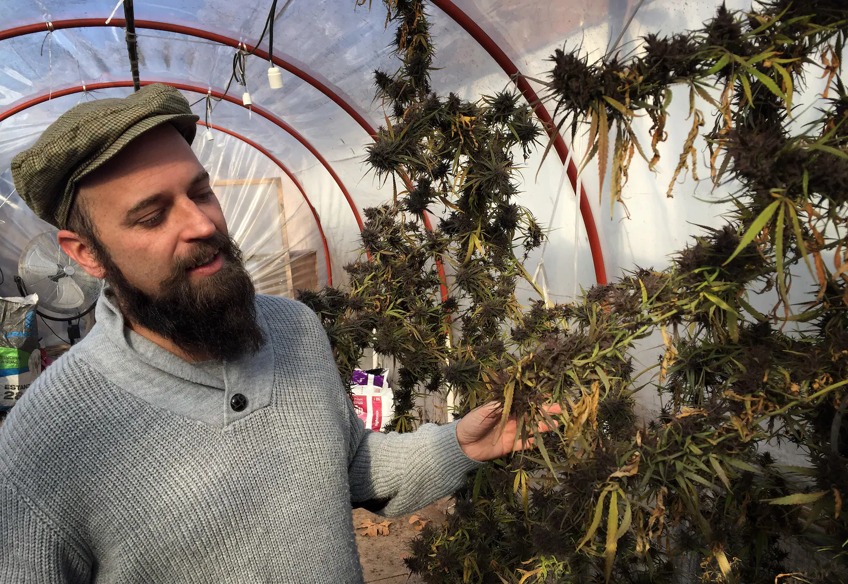
Ideal Experiment
Policy makers force universities to randomly admit people so there can be two groups:
Educated
Not educated
All countries listed have legalized cannabis
Use surveys to understand people’s demographics, personality and cannabis consumption
Everyone told the truth
Separate the results by different educational levels and correlate that with cannabis consumption
Everyone that used cannabis only used recreationally

Slide 7
Our Dataset
 | Variables | Description
Dependent Variable | Cannabis | Level of cannabis consumption; Never Used, Used over a Decade Ago, Used in Last Decade, Used in Last Year, Used in Last Month, Used in Last Week, Used in Last Day
Independent Variables | Education | Highest education level obtained by participant
 | Gender | Gender of participant
 | Country | Country of origin of participant
 | Ethnicity | Ethnicity of participant
Data source: https://www.kaggle.com/datasets/obeykhadija/drug-consumptions-uci?select=Drug_Consumption_Quantified.csv

Slide 8
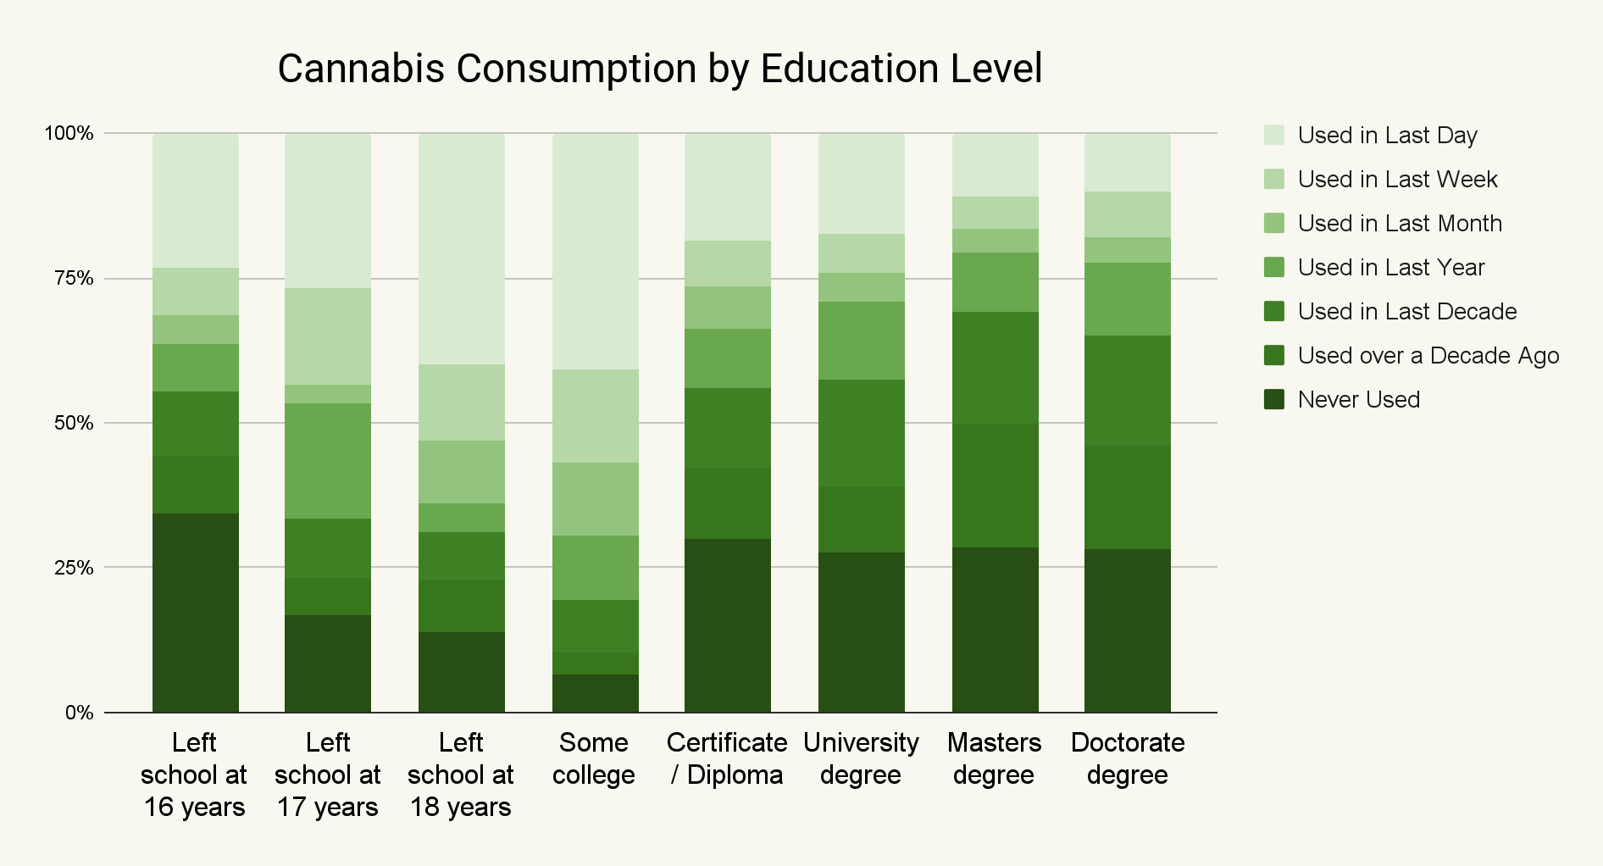
Understanding the Data
Findings
“Left school at 18 years” category has a significantly higher response rate of “Used in Last Day” when compared to “Doctorate degree” category.
Individuals that have completed a higher education seem to consume cannabis less regularly
1
1
1
2
2

Slide 9
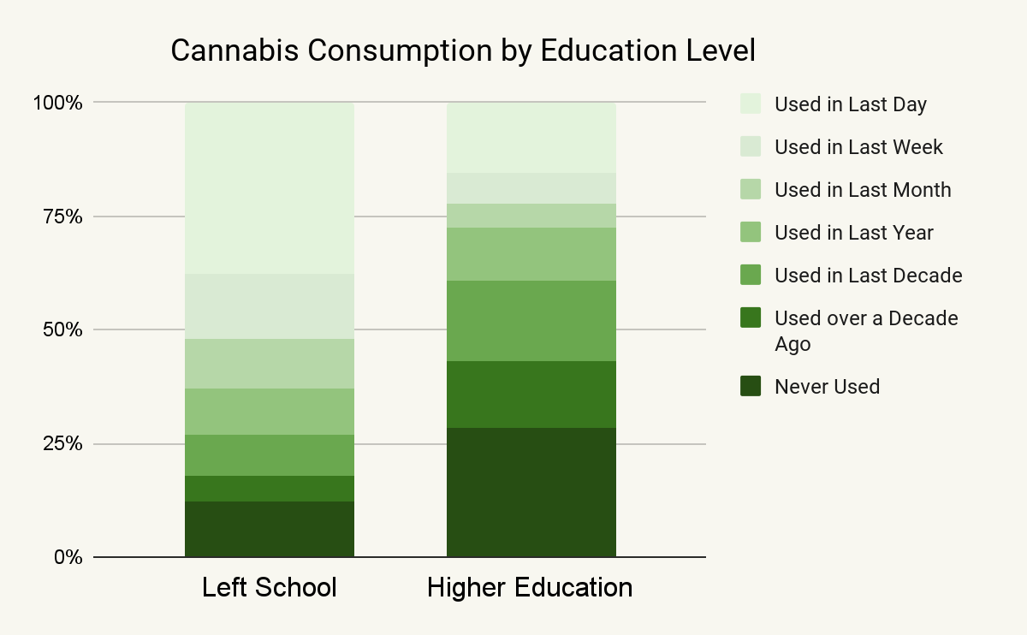
Understanding the Data (cont.)
After grouping education level into these categories, it seems clear that “Higher Education” consumes cannabis less regularly.

Slide 10
Data Cleaning and Data Manipulation
01
02
03
Categorical
Explanatory Variables
Education Level | Count
Left school before 16 years | 28
Left school at 17 years | 30
Doctorate degree | 89
Left school at 16 years | 99
Left school at 18 years | 100
Professional certificate/ diploma | 269
Masters degree | 283
University degree | 480
Some college or university, no certificate or degree | 506
Grand Total | 1884
Created dummy variables to handle categorical explanatory data
Categorical
Response Variable
Education Level | Count
Higher Education | 1121
Left School | 763
Grand Total | 1884
Converted categorical response variable to binary data; 1 if consumed cannabis within past month, 0 if not
Unequal Distribution
Divided education levels into two buckets: Left School & Higher Education

Slide 11
Results
R-squared: Adj. R-squared: Prob (F-statistic) | 0.124 0.124 <0.000
Model 1
Treatment | coeff | t | P>|t|
Intercept | 0.2748 | 19.919 | 0.000
Education[T. Left School] | 0.3543 | 16.348 | 0.000
Notes:
We wanted to establish a baseline
Only control for education (model 1)
And control for all variables (model 2)

Slide 12
Results
R-squared: Adj. R-squared: Prob (F-statistic) | 0.325 0.320 <0.000
Model 2
Treatment | coeff | t | P>|t|
Intercept Education[T. Left School] Gender[T.M] Ethnicity[T.Black] Ethnicity[T.Mixed-Black/Asian] Ethnicity[T.Mixed-White/Asian] Ethnicity[T.Mixed-White/Black] Ethnicity[T.Other] Ethnicity[T.White] Country[T.Canada] Country[T.New Zealand] Country[T.Other] Country[T.Republic of Ireland] Country[T.UK] Country[T.USA] | 0.3095 0.1683 0.1489 0.0646 0.4949 0.2947 0.1361 0.2316 0.1604 -0.1272 0.1436 -0.0405 -0.0028 -0.3745 0.0708 | 3.185 8.101 7.632 0.605 1.989 2.391 1.122 2.425 1.989 -1.801 0.755 -0.604 -0.026 -6.567 1.214 | 0.001 0.000 0.000 0.545 0.047 0.017 0.262 0.015 0.047 0.072 0.450 0.546 0.979 0.000 0.225

Slide 13
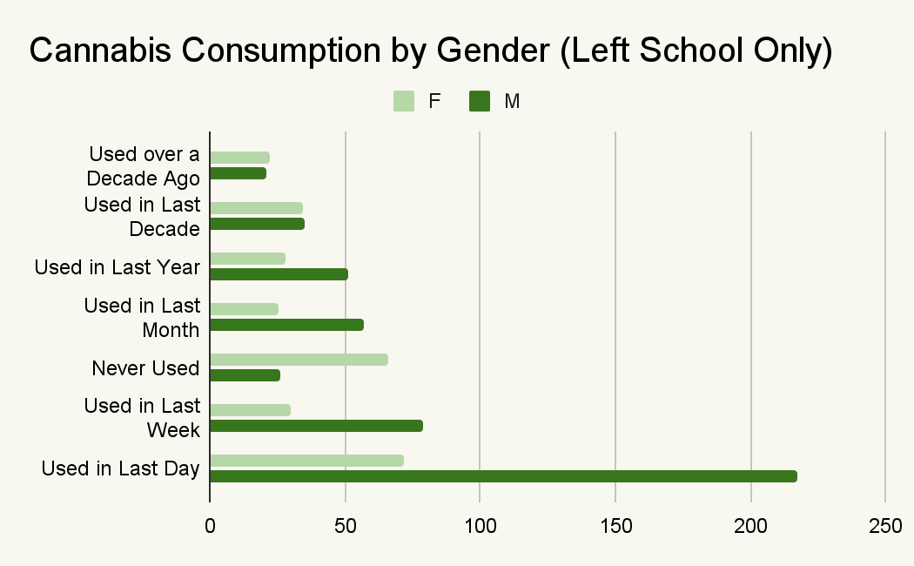
Further Analysis
When filtering for education level equal to “Left School”, there appears to be a stark difference in cannabis consumption by gender

Slide 14
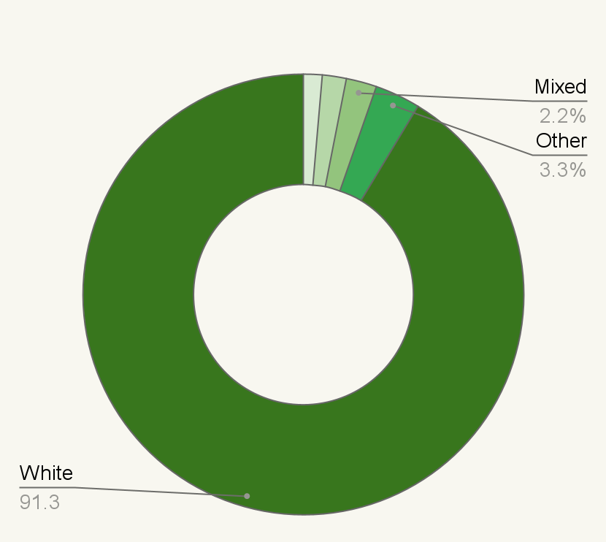
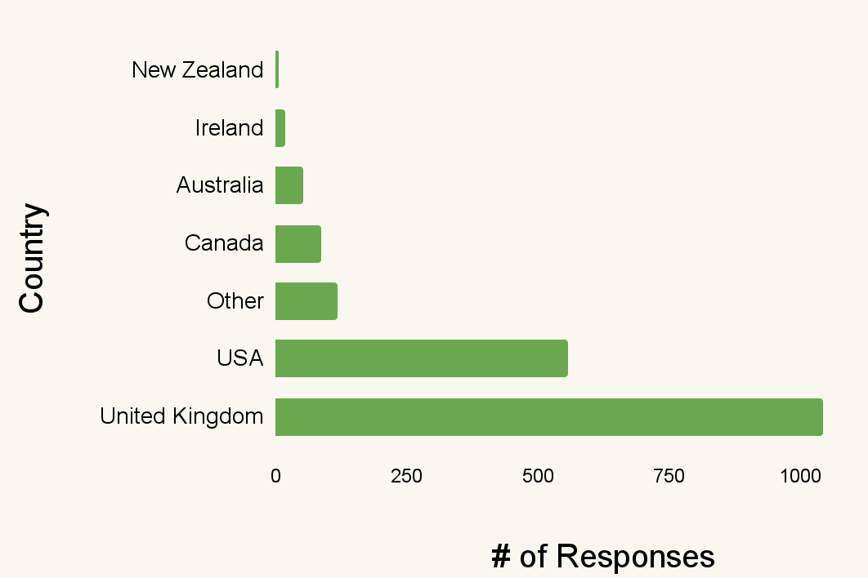
Conclusion
We reject the null hypothesis.
There is sufficient evidence to suggest that not pursuing higher education will increase the likelihood that a person consumes cannabis within the next month.
Improvements
Ethnicity
Mixed
More countries/ethnicities
Data on legality
Greater sample size
Other
Country
# of responses
White

Slide 15
Results
R-squared: Adj. R-squared: Prob (F-statistic) | 0.327 0.322 <0.000
Model 3
Based on the regression result, t-value for Education is 3.827 which is greater than the critical value 1.96 at the 95% confidence level
Treatment | coeff | t | P>|t|
Intercept Education[T. Left School] Gender[T.M] Ethnicity[T.Black] Ethnicity[T.Mixed-Black/Asian] Ethnicity[T.Mixed-White/Asian] Ethnicity[T.Mixed-White/Black] Ethnicity[T.Other] Ethnicity[T.White] Country[T.Canada] Country[T.New Zealand] Country[T.Other] Country[T.Republic of Ireland] Country[T.UK] Country[T.USA] Education[T. Left School]:Gender[T.M] | 0.3303 0.1143 0.1099 0.0590 0.4900 0.2839 0.1123 0.2315 0.1552 -0.1273 0.1413 -0.0401 0.0008 -0.3743 0.0708 0.0989 | 3.391 3.827 4.407 0.554 1.972 2.304 1.009 2.428 1.927 -1.805 0.744 -0.599 0.008 -6.572 1.215 2.511 | 0.001 0.000 0.000 0.580 0.049 0.021 0.313 0.015 0.054 0.071 0.457 0.549 0.994 0.000 0.224 0.012
Notes:
Based on “further analysis” slide, we want to run the regression model again, this time including an interaction term with education and gender
Result: when controlling for education, gender, ethnicity, country, and the interaction between education and gender, individuals that do not pursue higher education are expected to be, on average, 11.43% more likely to consume cannabis within the next month

Slide 16
Thank you!

